Slide 1
Ballerina Hacktone
Team Cybus

Slide 2
Our Team
Rushan Arunod
Yasas De Silva
Priyashani Fernando
Channa Jayamuni

Slide 3
Our Concept :CYBUS
Create a business platform to connect various interconnected business api services together. All the services are configurable manner and it can be used for any business platform. Example: Banks, Restaurants. At the initial stage, we are going to interconnected basic restaurant services (food) together.

Slide 4
Implementation: Restaurant Finder
Interconnected various expectations of food related stakeholders like restaurants’, and food lovers’ e.g. get to know information related to restaurant
Services like location, promotions and advertise promotions as well as publish selfies in social media will address in the restaurant finder app.

Slide 5
App features
Find restaurants close to you using you current location.
See details of a restaurant; location, rating, reviews etc.
News feeds to show promotions and other important news to food lovers
News feeds link with Facebook and Twitter page of cybus-foodcourt
Panel for Comments or feedback of the customer

Slide 6
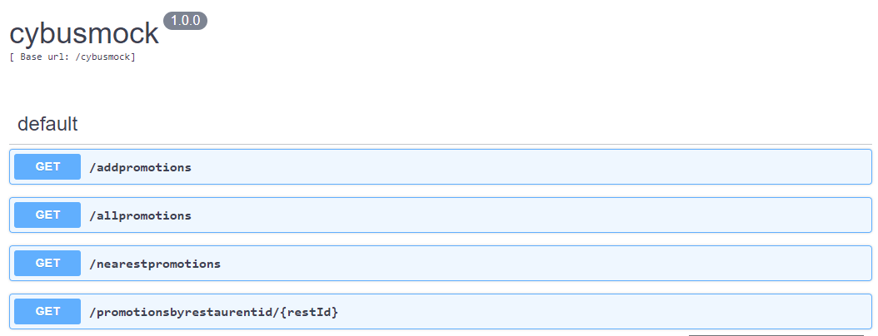
APIs Exposed from Ballerina

Slide 7
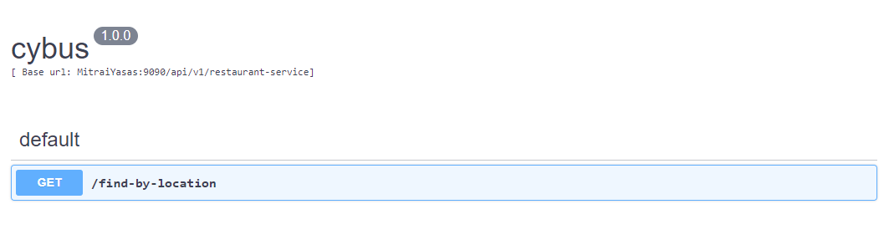
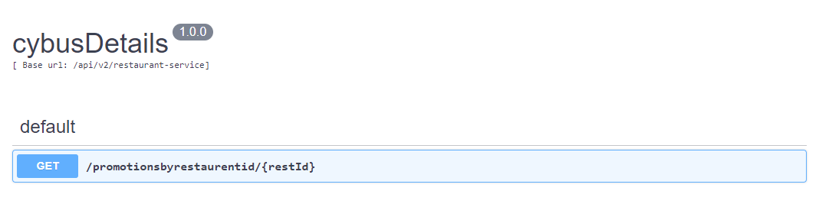
APIs Exposed from Ballerina

Slide 8
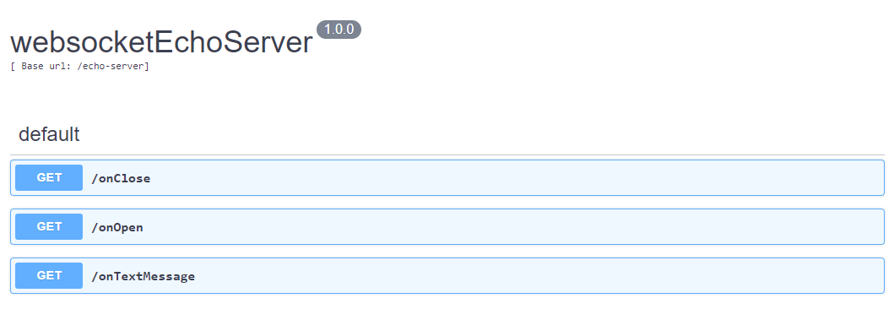
APIs Exposed from Ballerina

Slide 9
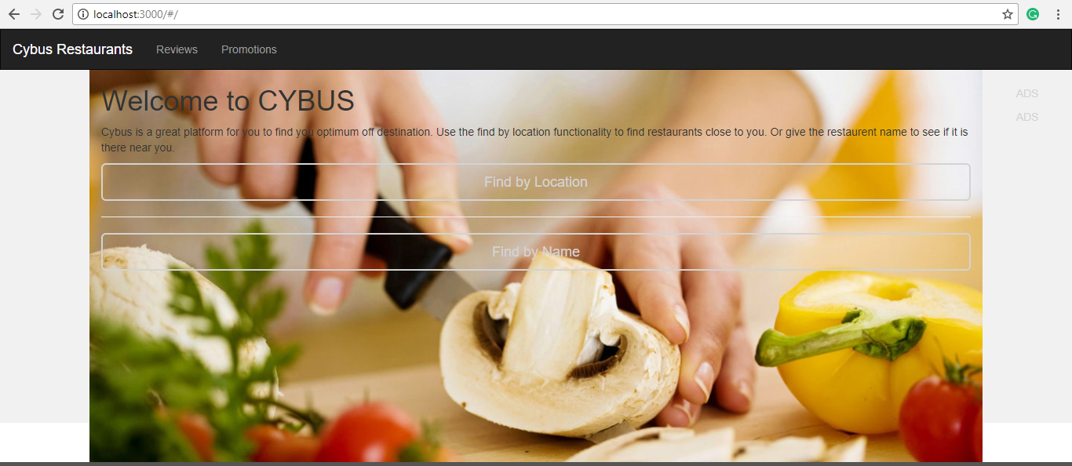
Cyber App

Slide 10
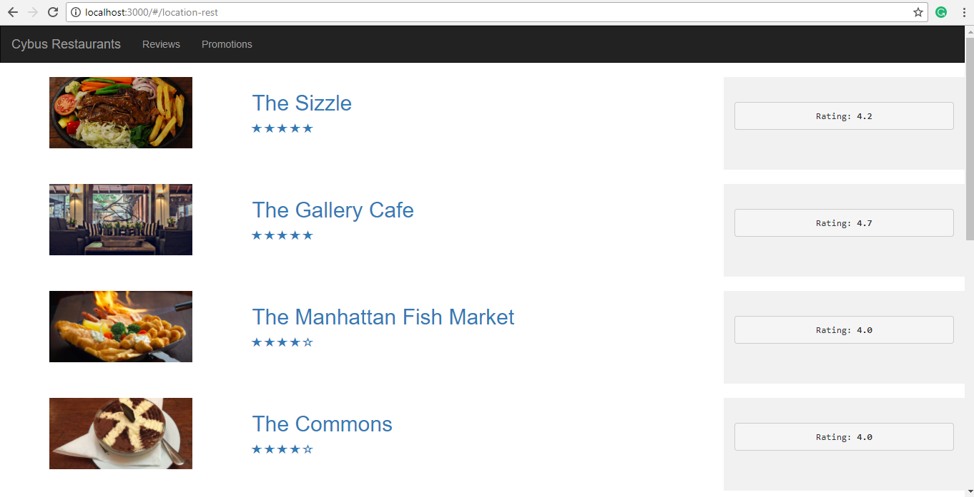
Cyber App

Slide 11
How we use Ballerina...
To convert tabular data in a database as a JSON response (REST API)
To create and maintain session between server and client (Web Socket)
To notify client with many backend updates.
For service chaining.

Slide 12
Why Ballerina?
- Can easily write communication between a database (tabular data) and web services (REST) faster that other available methods. (E.g.: Java JAX-rs)
- When it comes to Web sockets ballerina has a Global Connection Store.
Using the connection store you can update many clients within seconds
Can manage connections in groups. So that with out filtering we can send notifications directly to the clients in those particular groups.

Slide 13
THANK YOU

